Slide 1
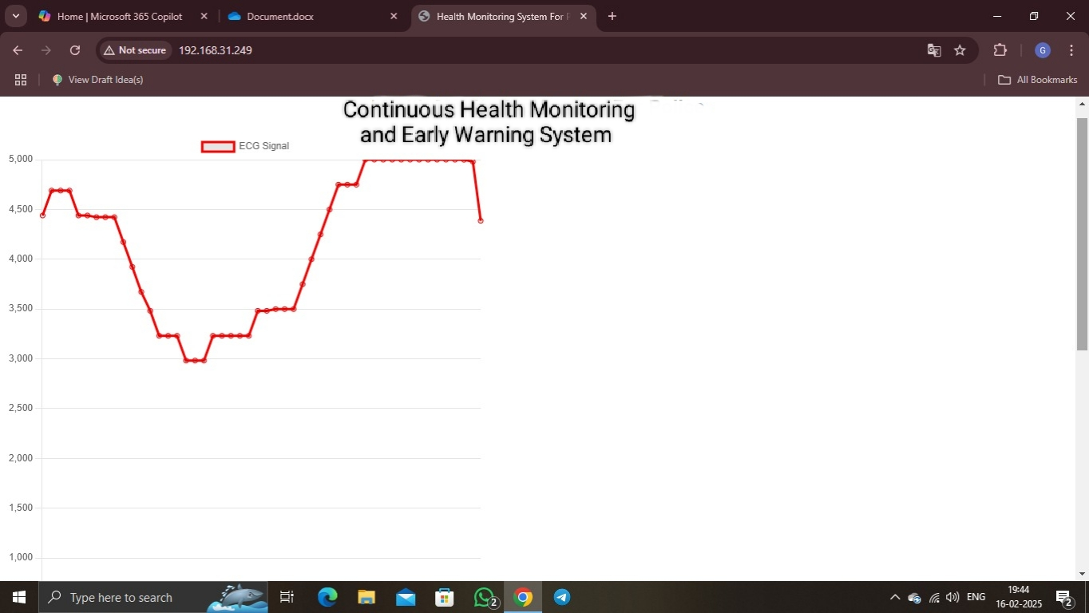
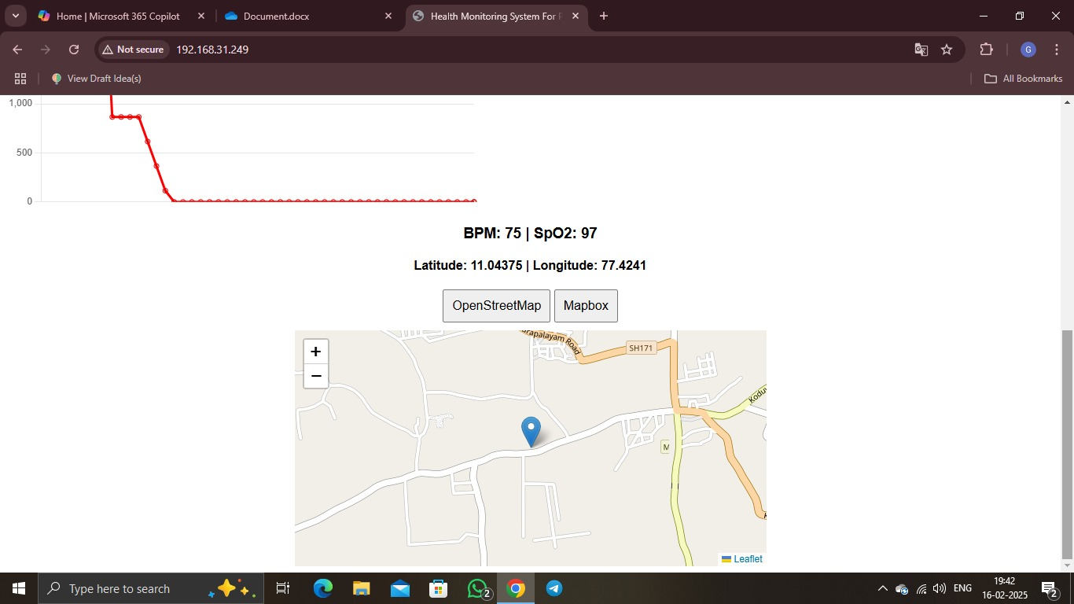
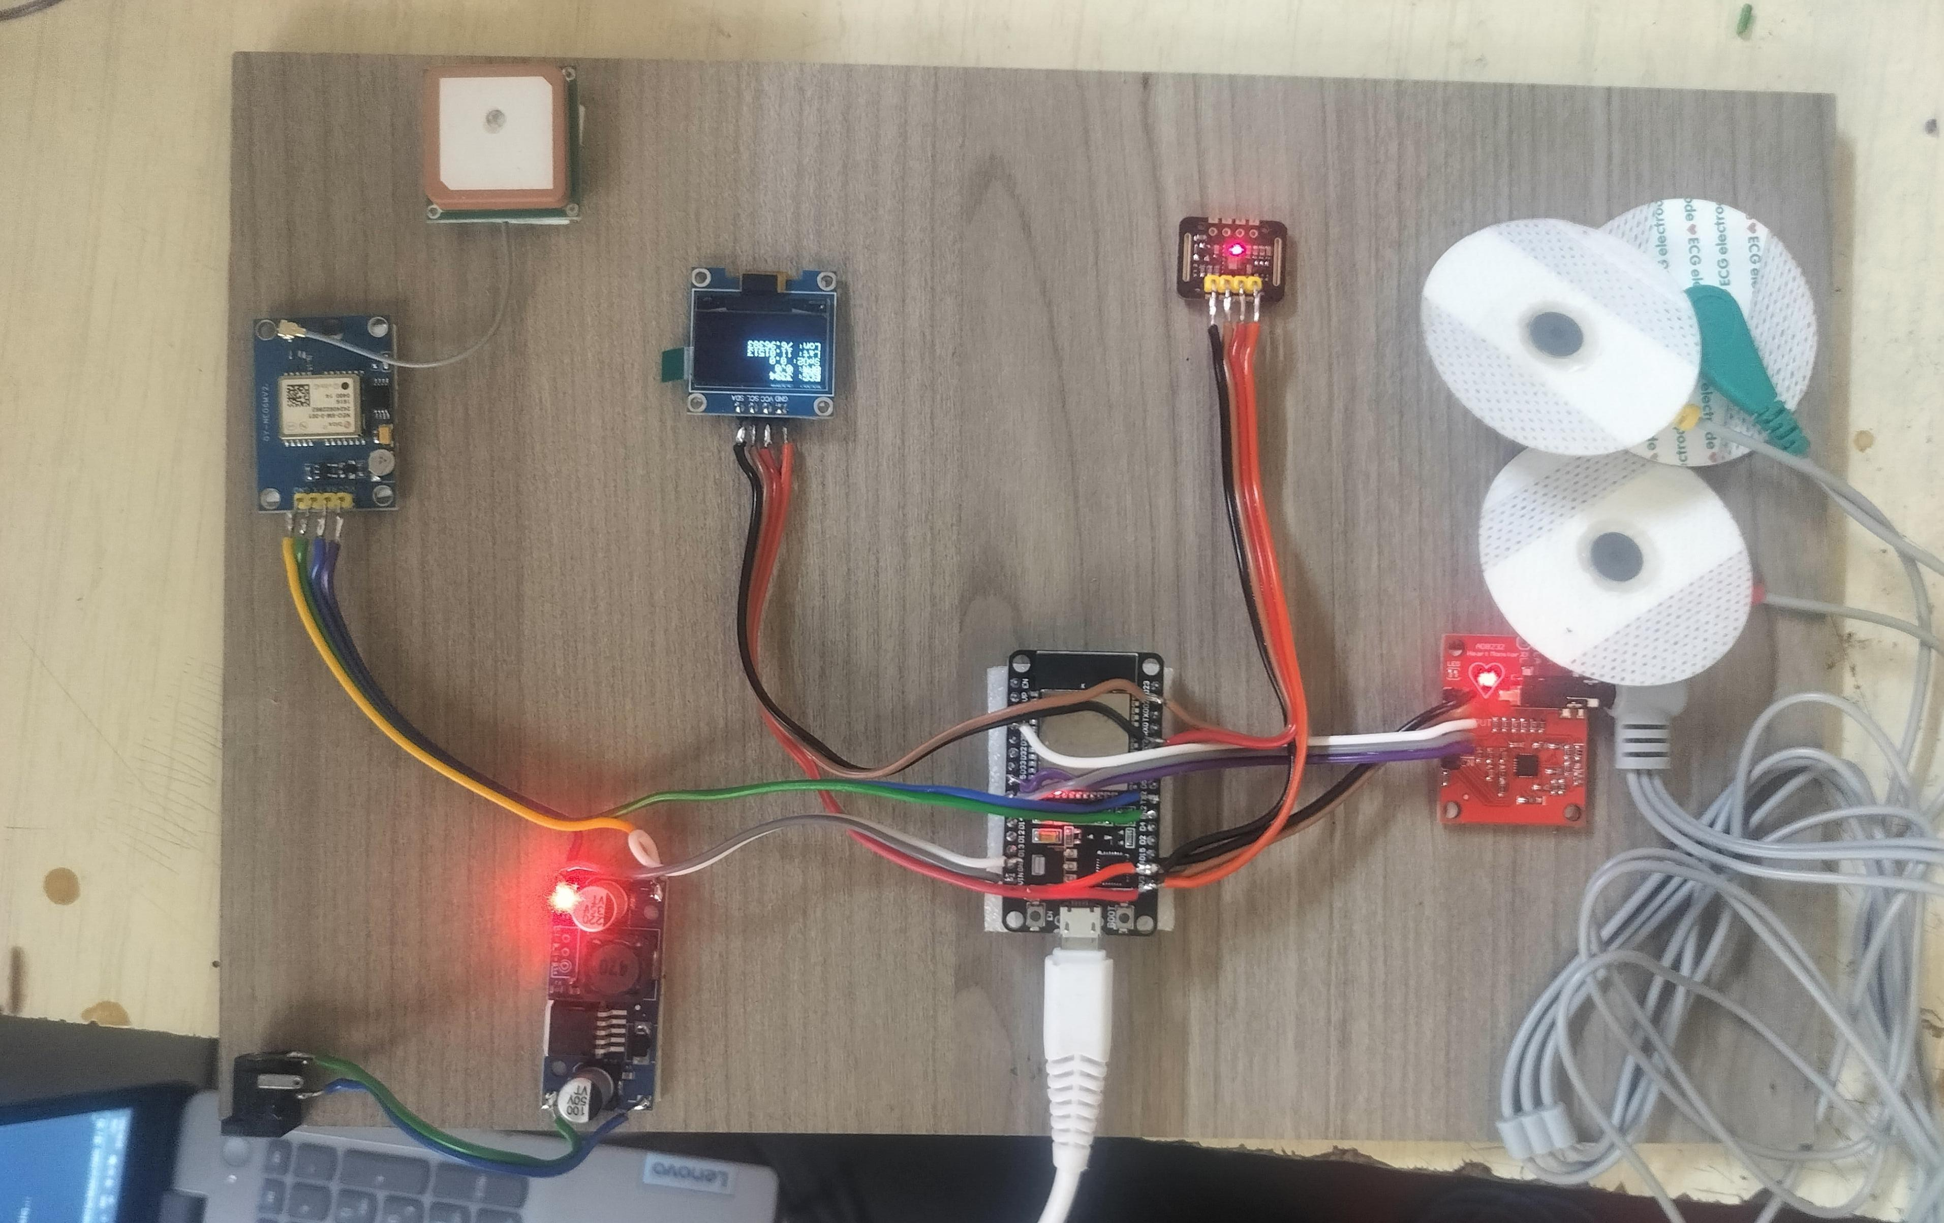
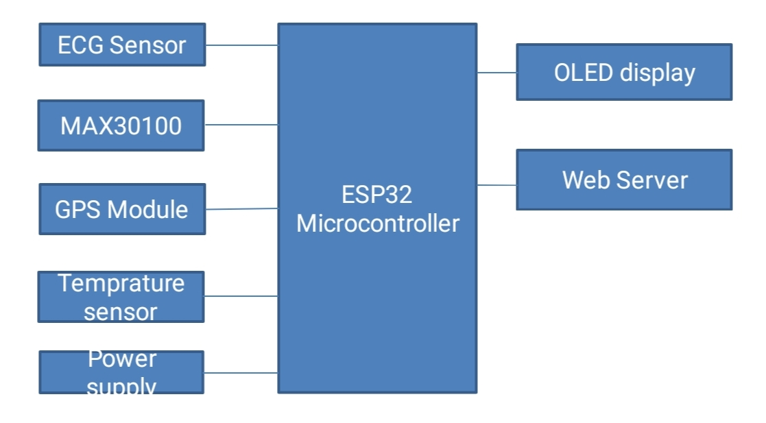
VitaTrack: A Wearable Device for Continuous Health Monitoring and Early Warning System
Dr.G. Vetrichelvi¹, Gowtham R², Anurag Singh², Bala Siva Krishna², Infanta Christina Lourthu Mary S²
Professor & HoD¹, Department of Electronics and Communication Engineering, Jansons Institute of Technology, Coimbatore
UG –Students², Department of Electronics and Communication Engineering, Jansons Institute of Technology, Coimbatore
Introduction
Results
Workers in hazardous environments are exposed to various health and safety risks, including extreme environmental conditions, physical exertion, and potential medical emergencies. Traditional health monitoring methods, such as periodic check-ups and manual supervision, lack real-time tracking and often result in delayed detection of critical health issues. This delay increases the risk of accidents, medical complications, and reduced efficiency in high-risk professions.
To address these challenges, VitaTrack: A Wearable Device for Continuous Health Monitoring and Early Warning Systems has been developed as an IoT-based solution for real-time health and environmental monitoring. This system integrates wearable biomedical sensors to continuously track heart rate (MAX30100 sensor), blood oxygen levels (SpO2), ECG signals (AD8232 sensor), and body temperature (MAX30208 sensor). Additionally, an integrated GPS module ensures real-time location tracking, allowing supervisors to monitor workers’ positions in high-risk areas. A panic button is included in the system, enabling users to send immediate emergency alerts if they experience distress. The ESP32 microcontroller processes the sensor data and transmits it to a web-based dashboard, where supervisors can remotely monitor real-time health metrics and location details. The system employs cloud computing and predictive analytics to assess trends in health data, triggering automated alerts if abnormal conditions are detected. These features help in early risk detection, allowing timely intervention and minimizing potential health hazards. By integrating IoT technology, real-time monitoring, and predictive analytics, VitaTrack significantly improves worker safety, reduces health risks, and enhances emergency response efficiency. The system bridges the gap between health monitoring and workplace safety, ensuring a proactive approach to risk
REAL-TIME DATA MONITORING THROUGH CLOUD
Objectives
Prototype
The objective of VitaTrack is to develop a comprehensive IoT-based health and safety monitoring system designed for individuals working in hazardous environments. This system aims to provide real-time tracking of essential vital health metrics, such as heart rate, SpO2 levels, body temperature, and ECG, along with environmental conditions that may pose health risks.
All collected data will be transmitted to a centralized web portal, enabling remote supervision and continuous monitoring by authorized personnel. The system is designed to support early detection of potential health risks, ensuring timely intervention and enhancing the safety and well-being of workers during duty. By integrating advanced sensor technology, wireless connectivity, and intelligent alert mechanisms, VitaTrack serves as a proactive health surveillance tool, significantly improving occupational safety and situational awareness in high-risk work environments.
Block diagram
Conclusion
VitaTrack is an IoT-based wearable health monitoring system designed for individuals working in hazardous environments. It continuously tracks vital health parameters like heart rate, SpO2, body temperature, and ECG, enabling real-time monitoring and early risk detection. With centralized web portal integration, VitaTrack allows remote supervision and timely intervention in emergencies. Its use of advanced sensors and wireless communication ensures accurate and efficient health monitoring for occupational safety. By providing continuous tracking, proactive alerts, and seamless connectivity, VitaTrack helps reduce health risks and enhances worker safety in high-risk environments.

